Slide 1

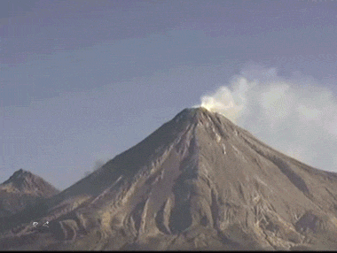
Title: How Do Volcanic Hazards Affect People, the Economy and the Environment?
LO: To explain how different volcanic hazards create social, economic and environmental impacts.
Date: Monday 7th September 2026
Title: Volcanic Hazards & Impacts
Last Lesson: Why are composite volcanoes more dangerous than shield volcanoes?
Two Weeks Ago: How do convection currents move tectonic plates?
Three Weeks Ago: How fold mountains are created at collision plate boundaries.

Slide 2
Title: How Do Volcanic Hazards Affect People, the Economy and the Environment?
LO: To explain how different volcanic hazards create social, economic and environmental impacts.
Success Criteria:
🔍 Meeting
Can identify and describe different volcanic hazards, including their causes and impacts.
🔗 Exceeding
Can explain how different volcanic hazards affect people and places, using relevant examples and evidence.
🧠 Mastering
Can analyse and evaluate different volcanic hazards, using evidence to assess which is most dangerous and explain why.
Key Enquiry Question:
“Why can one volcanic hazard have impacts on people, the economy and the environment?"

Slide 3



Title: How Do Volcanic Hazards Affect People, the Economy and the Environment?
LO: To explain how different volcanic hazards create social, economic and environmental impacts.
Keywords:
Social Impacts |  | Effects on people and communities. For example, injuries, deaths, loss of homes, or health problems.
Economic Impacts |  | Effects on money, jobs, and businesses. For example, damage to roads, airports, farms, or the cost of rebuilding.
Environmental Impacts |  | Effects on the natural world. For example, destroyed forests, polluted air, buried farmland, or changes to rivers and landscapes.

Slide 4
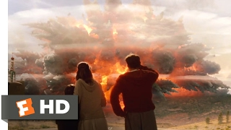
Title: How Do Volcanic Hazards Affect People, the Economy and the Environment?
LO: To explain how different volcanic hazards create social, economic and environmental impacts.
Volcanic Hazards
This clip is exaggerated for the film, but the order of events is realistic.
What volcanic hazards can you identify in this scene?
Notes:
http://www.youtube.com/watch?v=S1Kbym7WYzs

Slide 5
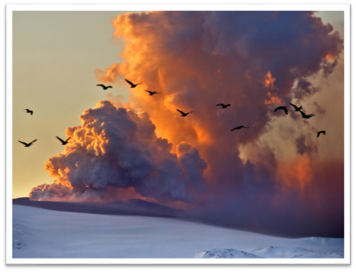
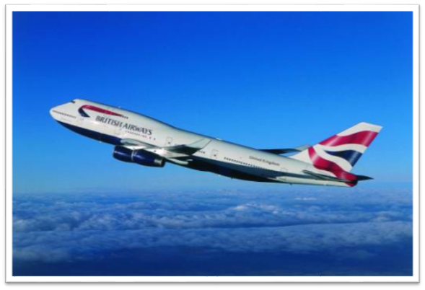
Title: How Do Volcanic Hazards Affect People, the Economy and the Environment?
LO: To explain how different volcanic hazards create social, economic and environmental impacts.
Impacts of Volcanic Hazards
How might this?
Impact this?

Slide 6
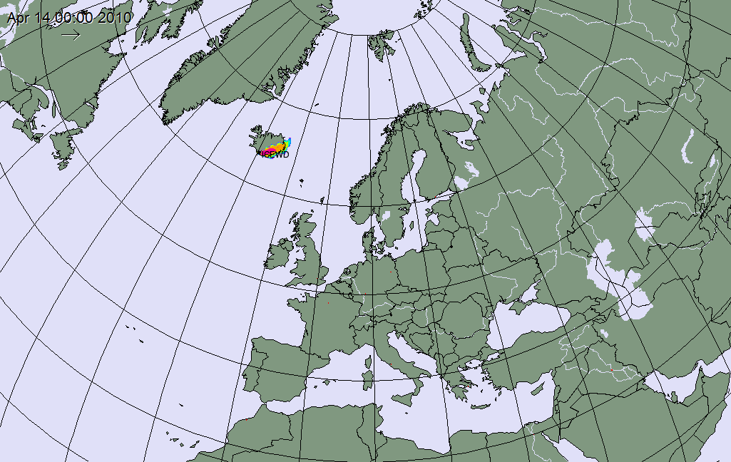
Title: How Do Volcanic Hazards Affect People, the Economy and the Environment?
LO: To explain how different volcanic hazards create social, economic and environmental impacts.
Turn & Talk:
What does this animation show about the 2010 eruption?
How might it have affected other countries?
Do you think the eruption caused bigger problems for Iceland or for the wider world?

Slide 7
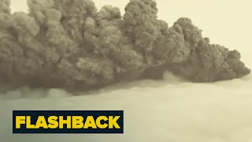
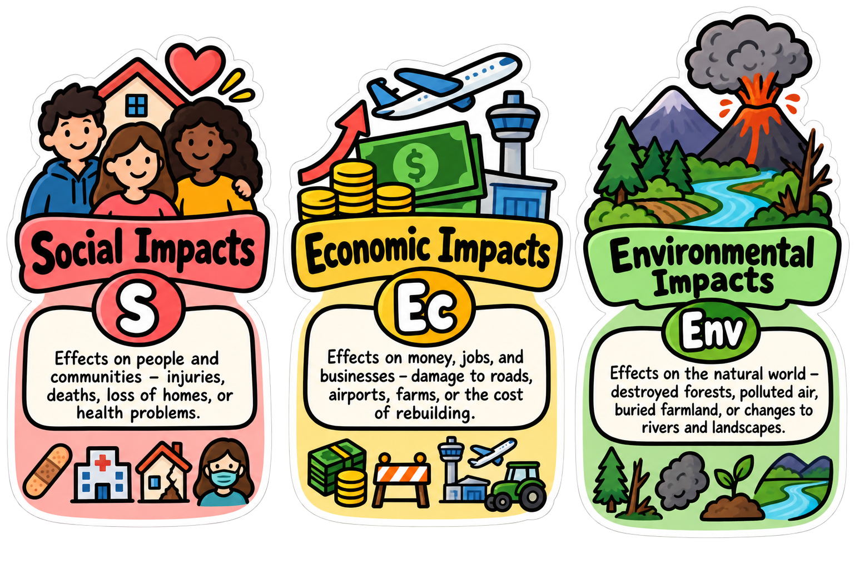



Title: How Do Volcanic Hazards Affect People, the Economy and the Environment?
LO: To explain how different volcanic hazards create social, economic and environmental impacts.
On the 20th March 2010 the Eyjafjallajökull (AY-ya-FYAT-la-YO-kutl) in Iceland began to erupt, and it had far reaching impacts…
Are these:
The ash cloud caused breathing problems for people nearby.
More than 100,000 flights were cancelled because of the ash cloud.
Crops were damaged because volcanic ash blocked sunlight.
Rivers in Iceland rose by about 3 metres.
Airlines lost up to $200 million every day.
Sports games and concerts were cancelled across Europe.
Notes:
https://www.youtube.com/watch?v=OyZHZhYDWNk

Slide 8

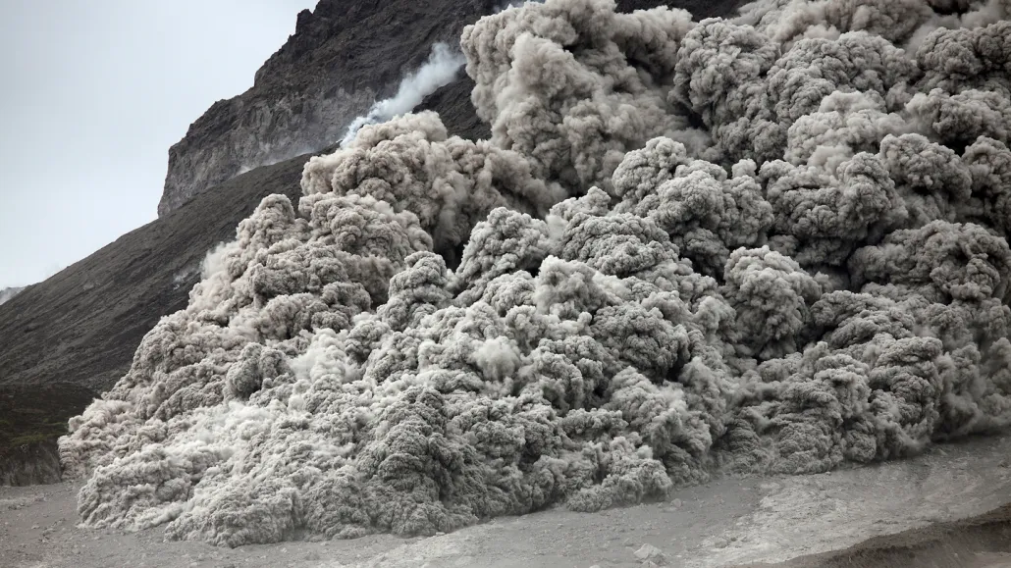
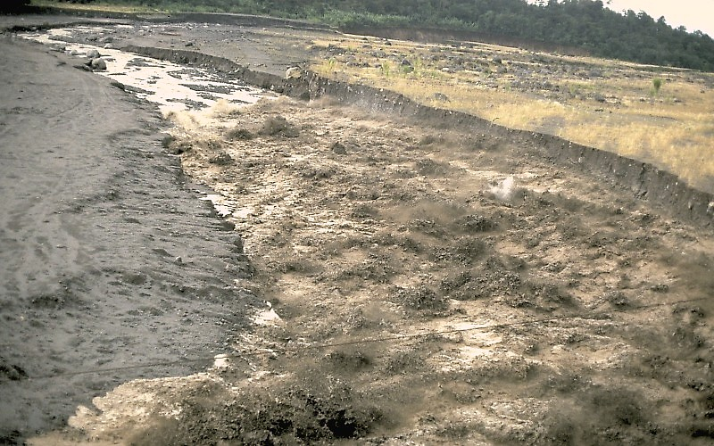
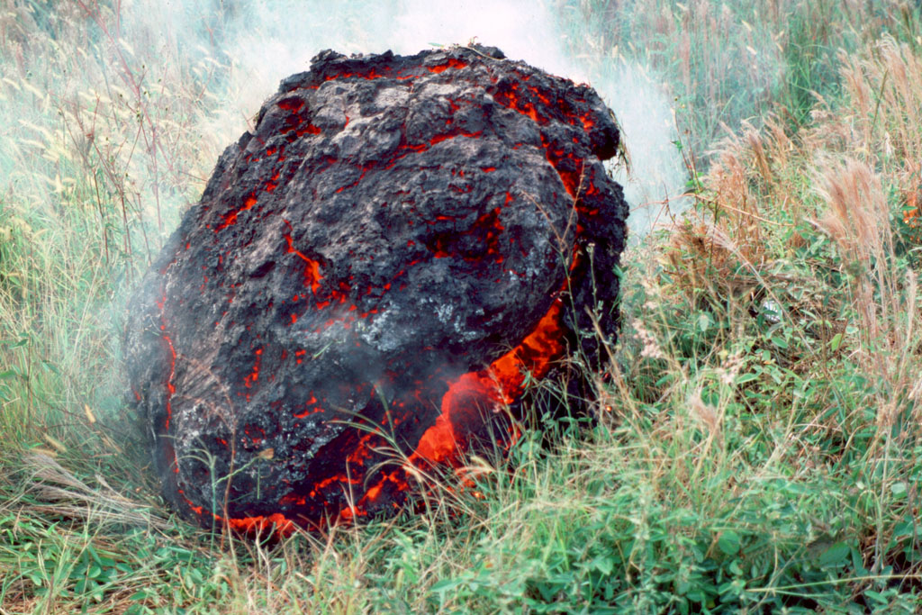
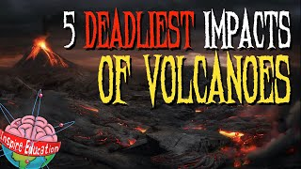
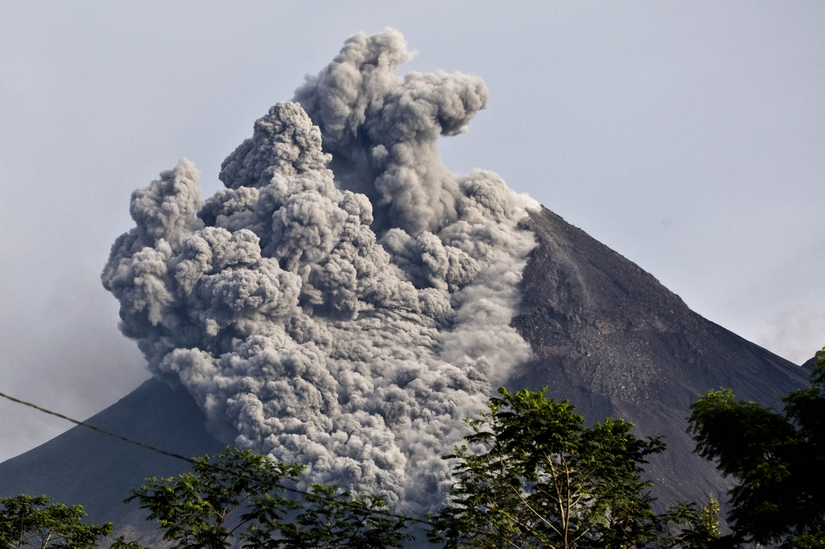
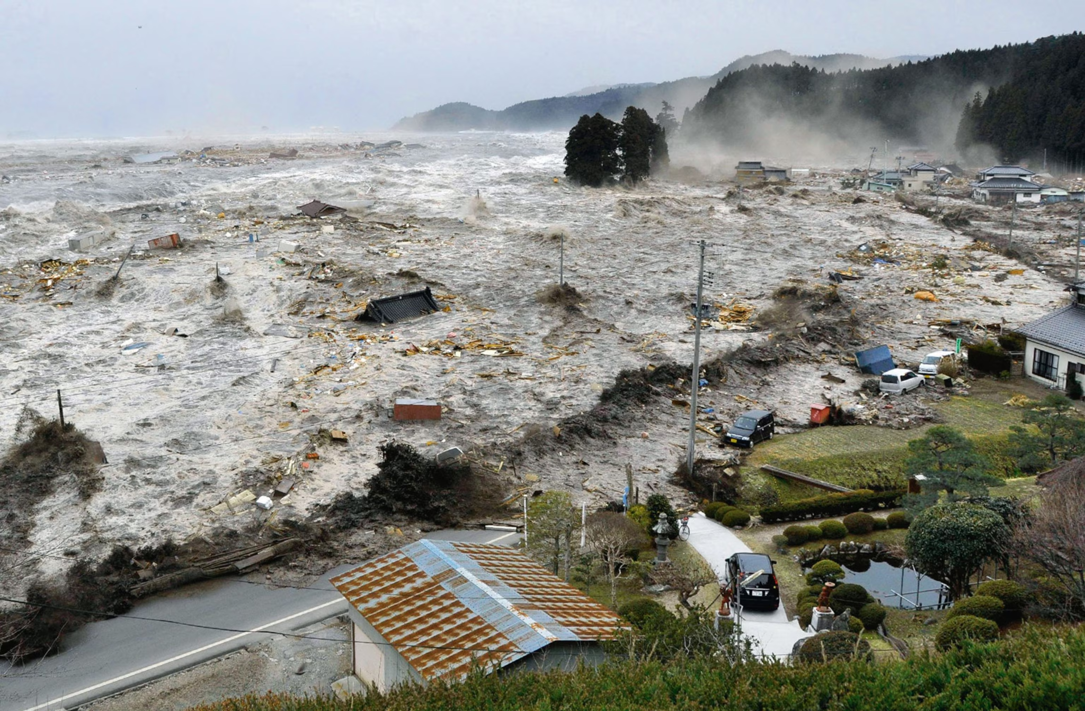

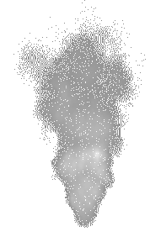
Title: How Do Volcanic Hazards Affect People, the Economy and the Environment?
LO: To explain how different volcanic hazards create social, economic and environmental impacts.
Volcanic Hazards
Activity: Pictures A-F are ways in which volcanoes can pose hazards to people and the environment. While watching the video, match the statement to the correct picture.
A
B
C
D
E
Activity 2: Complete the gap-fill.
Do volcanic hazards have a greater impact on people socially, economically, or on the environment?
Notes:
https://www.youtube.com/watch?v=OQAY2SEMtPg&t=125s https://www.youtube.com/watch?v=8thPJbbaKqM
A Lahar
B Pyroclastic flow
C Tephra
D Lava flow
E Landslide
F Volcanic Gases
https://www.youtube.com/watch?v=Cvjwt9nnwXY&feature=emb_title
https://www.youtube.com/watch?v=oeuPYDXVkuY&feature=emb_title

Slide 9

Title: How Do Volcanic Hazards Affect People, the Economy and the Environment?
LO: To explain how different volcanic hazards create social, economic and environmental impacts.
GREEN PEN YOUR ANSWERS
A: Pyroclastic Flow
B: Lahar
C: Volcanic Bombs
D: Volcanic Ash
E: Tsunami
Notes:
A Lahar
B Pyroclastic flow
C Tephra
D Lava flow
E Landslide
F Volcanic Gases
https://www.youtube.com/watch?v=Cvjwt9nnwXY&feature=emb_title
https://www.youtube.com/watch?v=oeuPYDXVkuY&feature=emb_title

Slide 10
Title: How Do Volcanic Hazards Affect People, the Economy and the Environment?
LO: To explain how different volcanic hazards create social, economic and environmental impacts.
GREEN PEN YOUR ANSWERS
A Lahar is a mixture of water, mud, ash and rocks that flows quickly down the side of a volcano. It can destroy roads and bridges. This is mainly an Economic impact.
A Tsunami is a huge ocean wave caused by an underwater volcanic eruption. It can flood coastal areas and destroy habitats. This is an Environmental impact.
Volcanic ash is made up of tiny pieces of rock and volcanic glass. It can be breathed in and cause breathing problems. This is a Social impact.
Volcanic bombs are large pieces of rock or lava thrown out of a volcano. They can damage buildings and vehicles. This is mainly an Economic impact.
A Pyroclastic flow is a very hot, fast-moving mixture of gas, ash and volcanic material. It can kill people and destroy homes. This is mainly a Social impact.

Slide 11
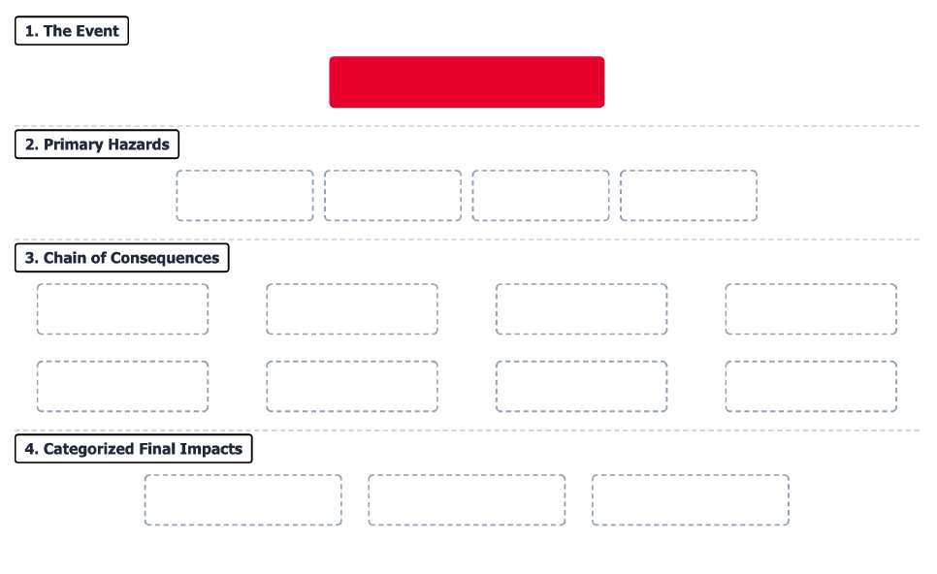
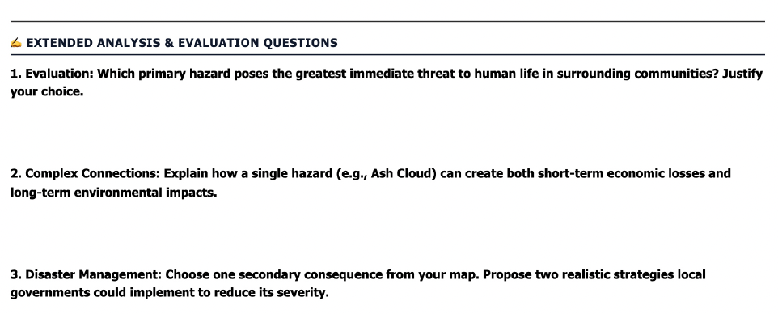
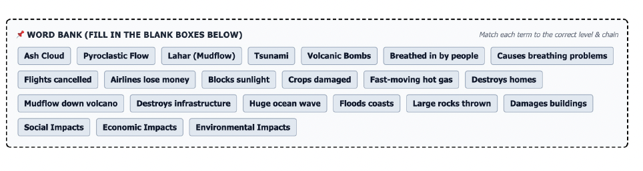

Slide 12

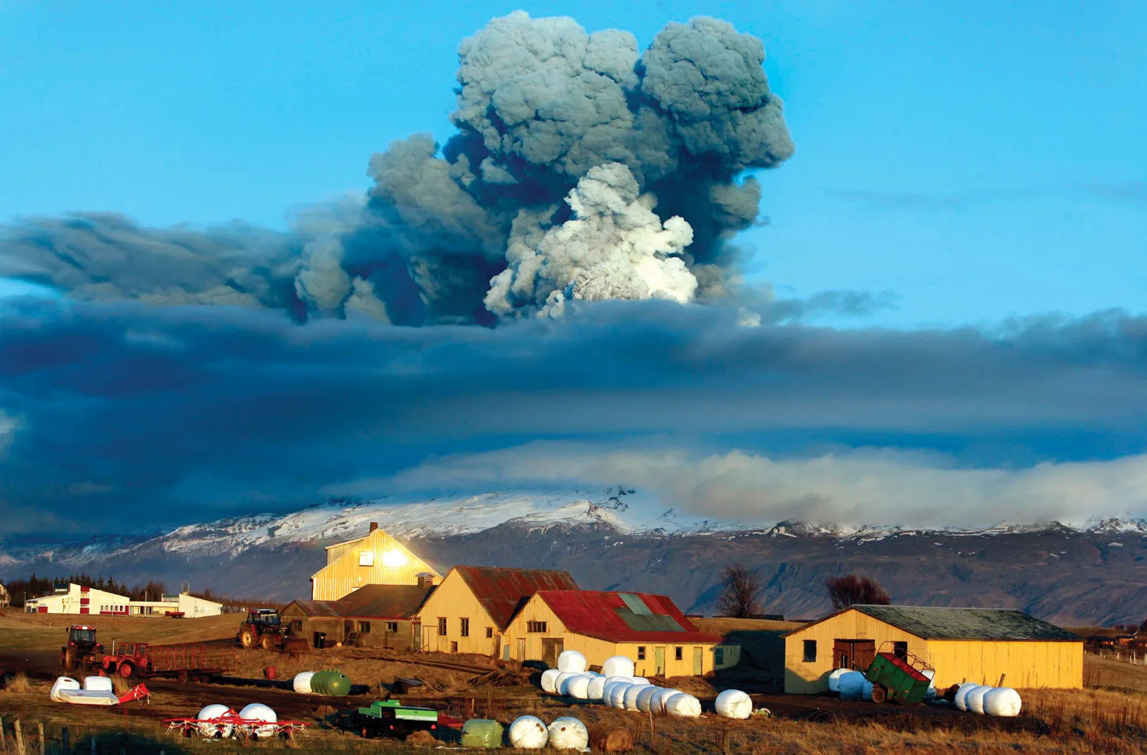

Title: How Do Volcanic Hazards Affect People, the Economy and the Environment?
LO: To explain how different volcanic hazards create social, economic and environmental impacts.
What have you learned about how volcanoes affect people, communities, and the environment?
Why is it important for scientists to understand and explain these impacts clearly?
Which volcanic impact do you think is the most serious, and why?
Notes:
https://dashboard.blooket.com/set/68c7b8951e8053292cd5b52b

